Slide 1
CAB FARE PREDICTION
GUIDED BY – DR.S.N.TIRUMULA RAO
EFFORT BY-
19471A05O9 - S. Sushma Priyanka
19471A05L8 - G. Roshini
20475A0517 - S. Sabeera Begam

Slide 2
Contents-
Abstract
Requirements
Existing system
Proposed system
Conclusion

Slide 3
ABSTRACT-
The main aim of the project is for predicting the longer-term events predictive analysis use data which is an archive.
Many industries use predictive analytics for making an accurate forecast like giving the amount of fare for the ride within the city.
These resource planning are enabled by forecast as an example cab fare can be predicted more accurately.
A lot of factors are taken into consideration for a cab startup company.
This research work tries to know the patterns and use different methods for fare prediction.
This research work is developed for predicting the cab fare amount within a certain city.
This research work involves different steps like training, testing by using different variables like pickup, drop-off, location for predicting cab fare.

Slide 4
REQUIRMENTS-
Hardware Requirements-
Processor : Intel(R) Core™2 i7-5500U CPU @2.50GHz RAM : 8GB(gigabyte) System Type : 64-bit operating system, x64-based processor
Software Requirements-
Browser : Any Latest browser like Chrome Operating System : Windows 10 Language : Python Platform : Google COLAB

Slide 5
EXISTING SYSTEM-
One of the major problems of travel, and transportation is solved by cab ride sharing.
According to a recent report most passengers approved of cab ride share.
The most common ways passengers use ride sharing are by booking a ride on an app, or by taking ride sharing services offline through a cab.
PROPOSED SYSTEM-
The proposed system looks for routes while satisfying certain travel conditions.
Stability of route here refers to the frequency of re-routing or transferring needs come up for a cab driver.
It helps in growing market in sub urban areas where predicting cab fares are not available.

Slide 6
The proposed method for the project is explained on 7 steps:
1. System Architecture
2. Raw Data
3. Data Importing
4. Data Visualization
5. Testing Data
6. Algorithm
7. Output Screens

Slide 7
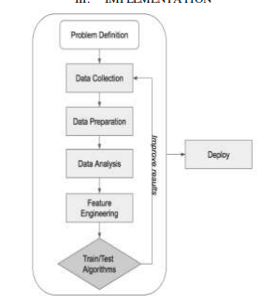
SYSTEM ARCHITECTURE

Slide 8
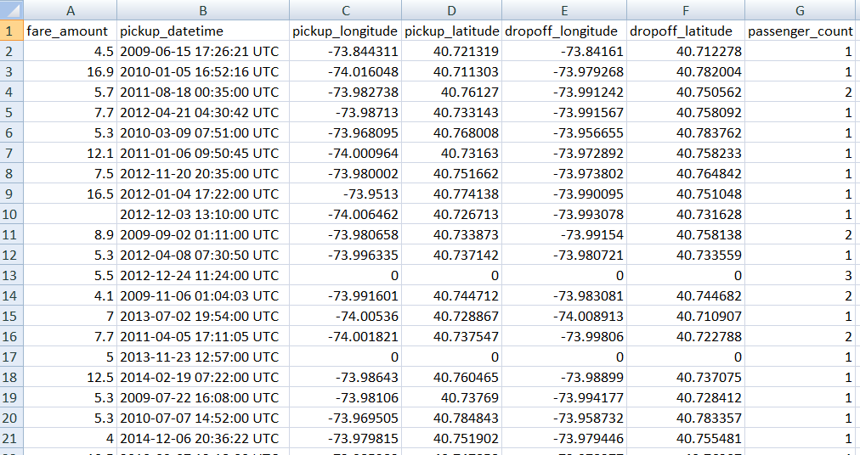
DATA SET
Attributes are:
1.fare_amount
2.Pickup_datetime
3.pickup_longitude
4.pickup_latitude
5.dropoff_longitude
6.dropoff_latitude
7.Passenger_count

Slide 9
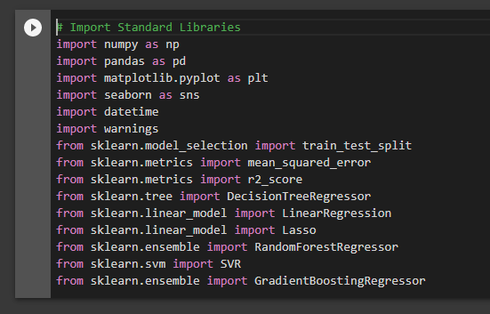
Fig : Importing library modules

Slide 10
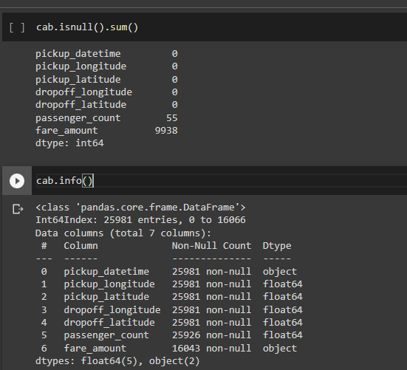
Fig: Checking null values and info of the dataset

Slide 11
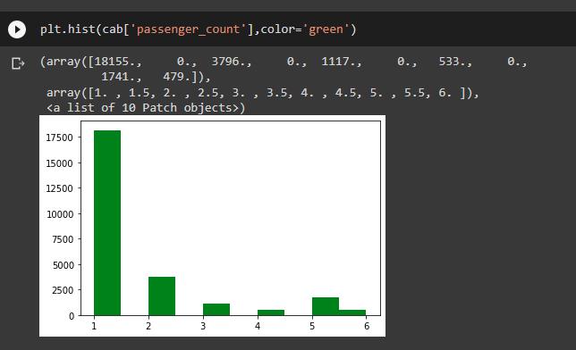
Fig: Single passengers are the most frequent travellers

Slide 12
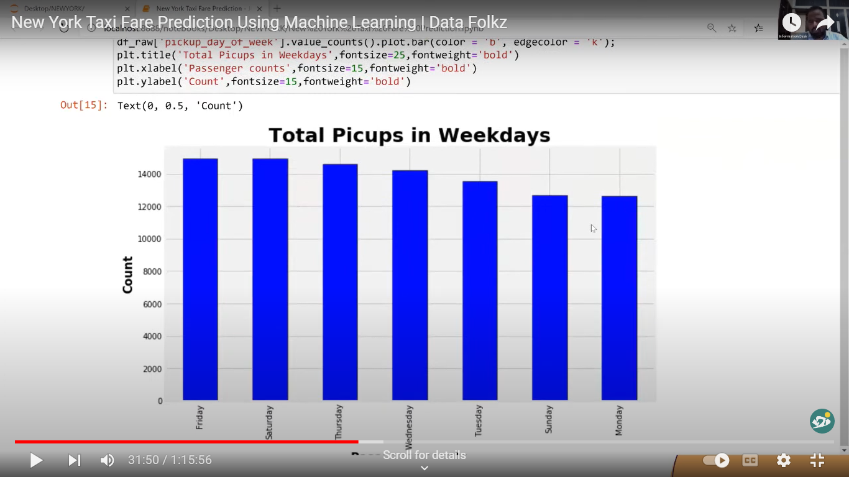
Fig: Checking if day of week effects the fare

Slide 13
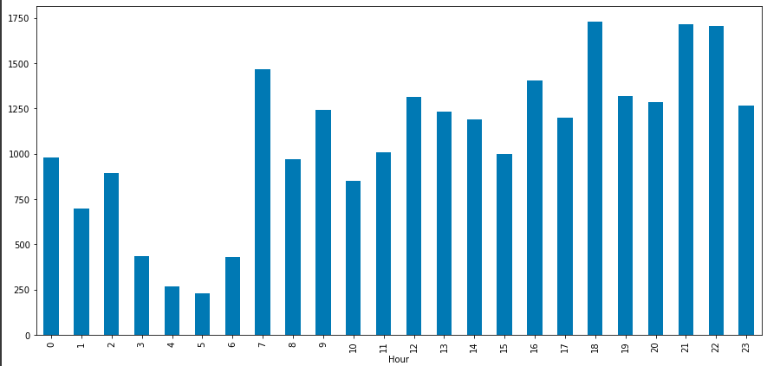
Fig: Checking if time effects the fare

Slide 14
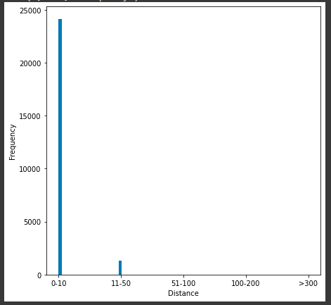
Fig: Most of the records are between the 0 to 10 kms

Slide 15
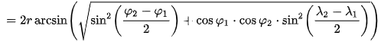
Calculating Distance Between Latitude and Longitude
The Haversine formula determines the great-circle distance between two points on a sphere given their longitudes and latitudes.
D
Where,
φ1,φ2 are the latitude of point1 and latitude of point2 (in radius),
λ1,λ2 are the longitude of point1 and longitude of point2 (in radius),

Slide 16
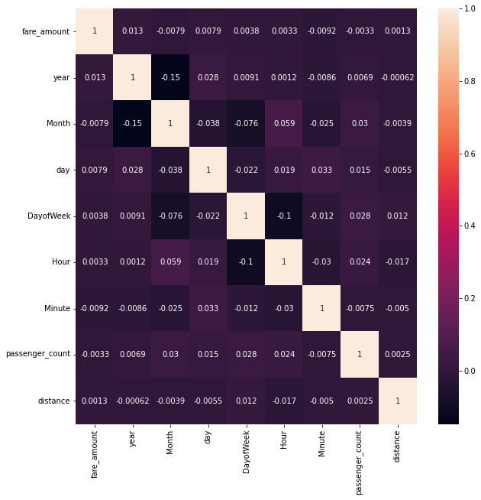
Fig: Correlation Of hours and week days

Slide 17
Algorithms used-
1. Linear Regression
2. Random Forest
3. Decision Tree
4. Gradient Boosting Regression
5. Support Vector Regression

Slide 18
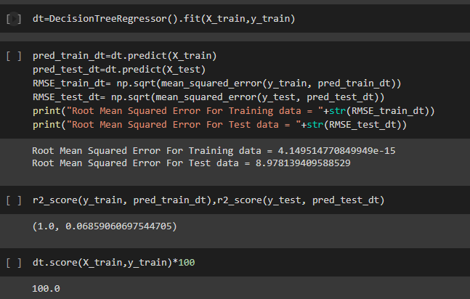
Decision tree algorithm-
Fig: Decision Tree Algorithm

Slide 19
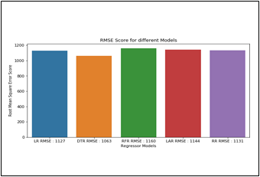
RMSE of the Decision Tree Algorithm is low when compared to all the algorithms. So, we have used decision tree algorithm.
Fig: RMSE Of Decision Tree

Slide 20
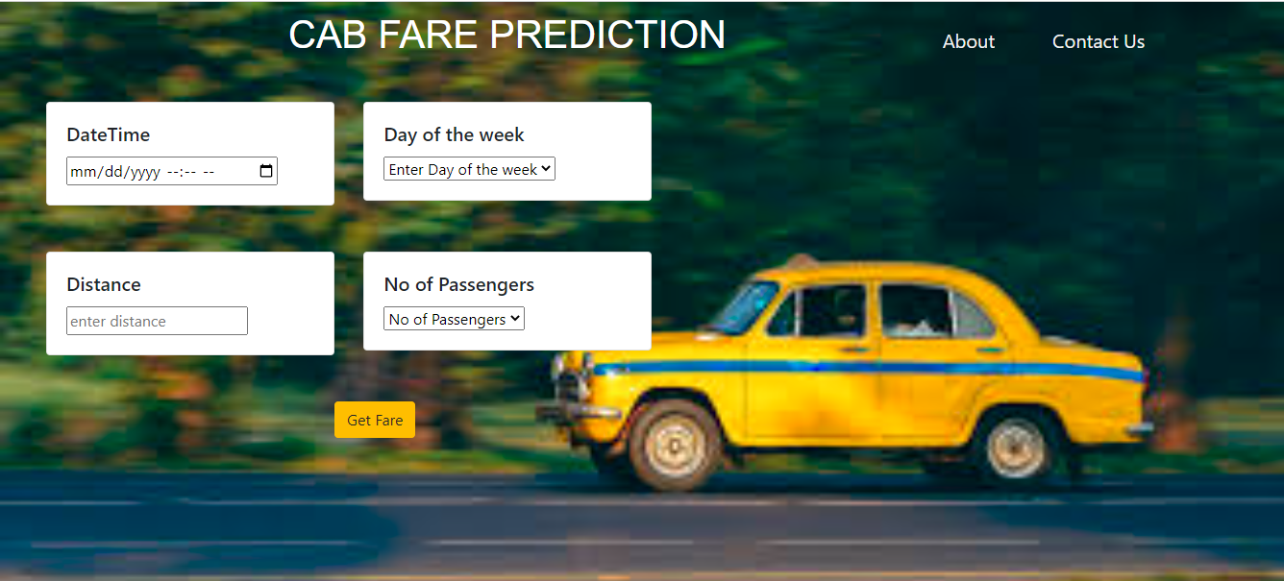
OUTPUT SCREENS
Fig: Output Screen for Prediction page

Slide 21
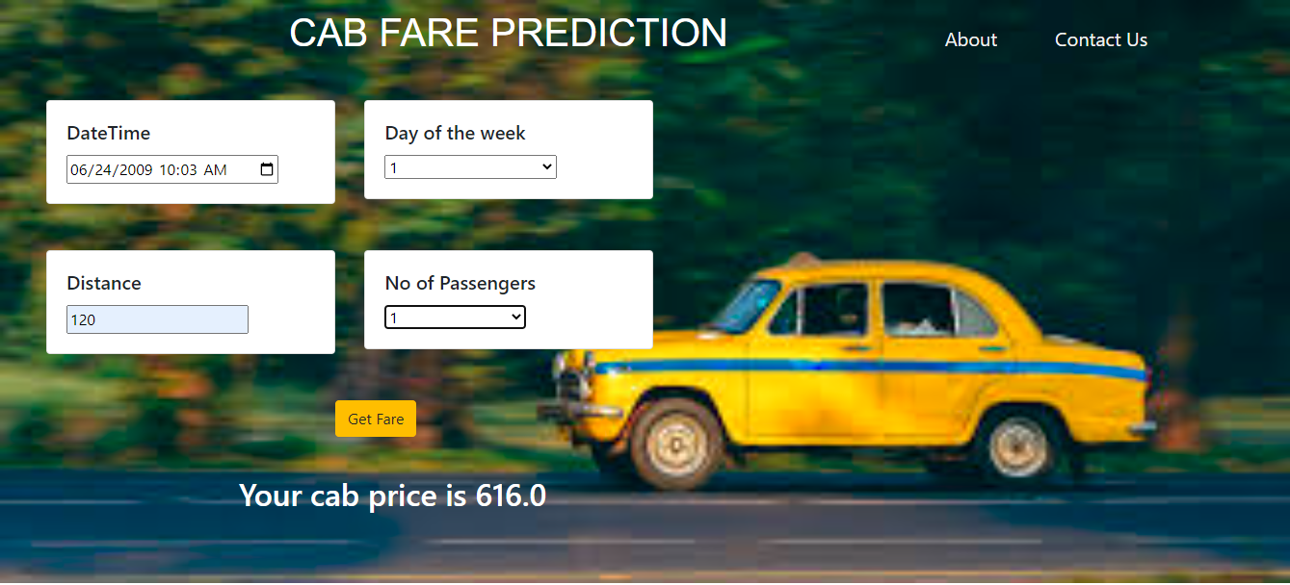
Fig: Output screen for output of the cab fare prediction

Slide 22
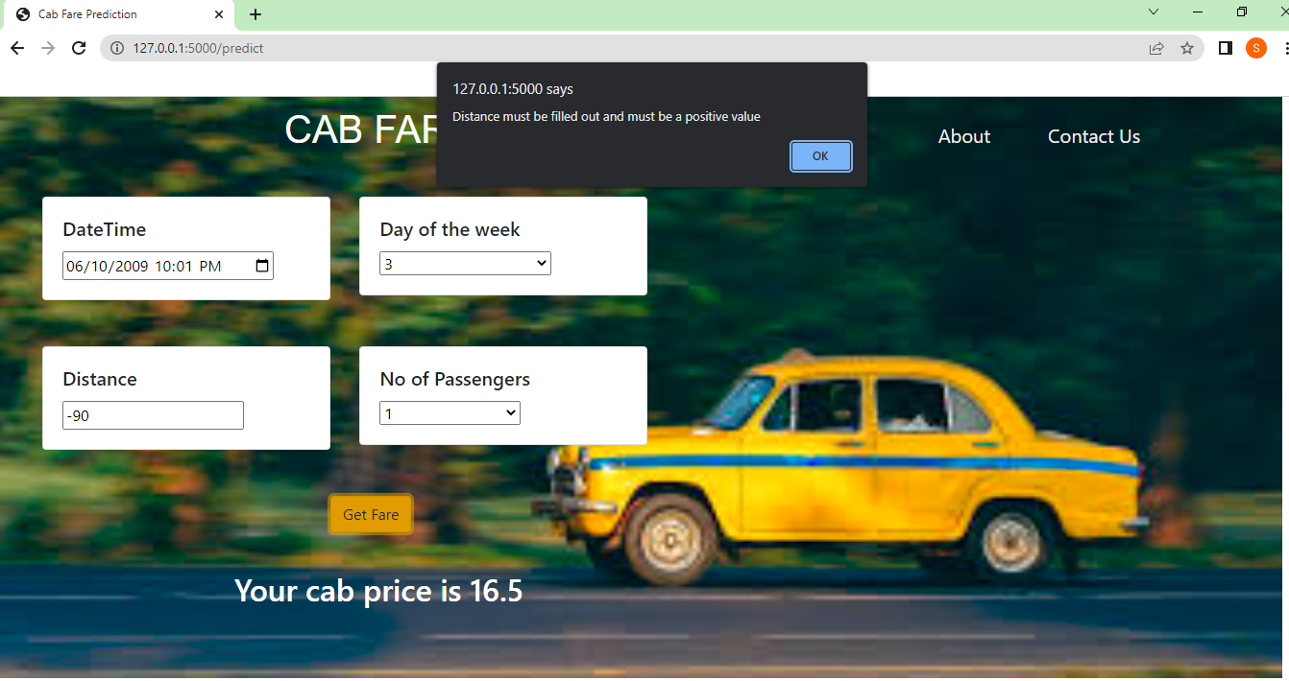
Fig: Output screen when distance is negative

Slide 23
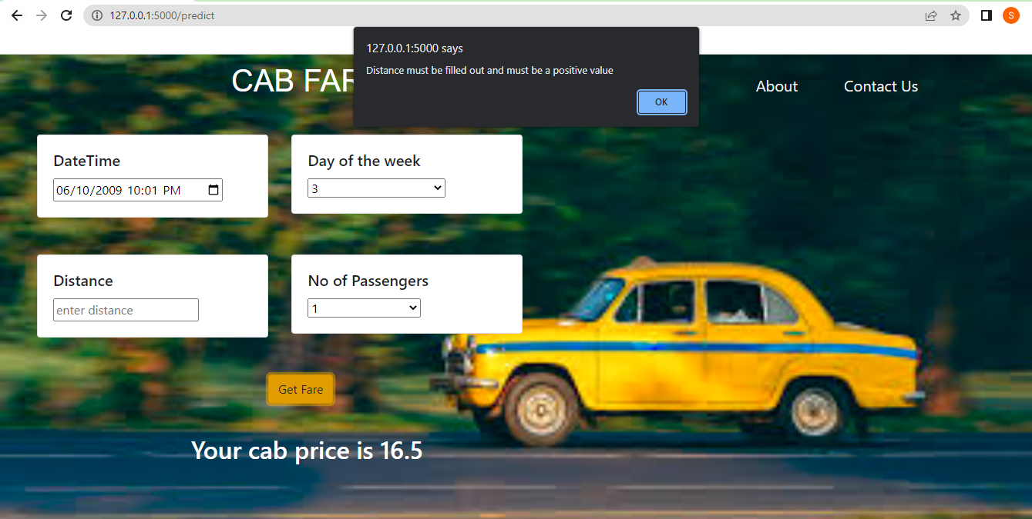
Fig: Output screen for distance is empty

Slide 24
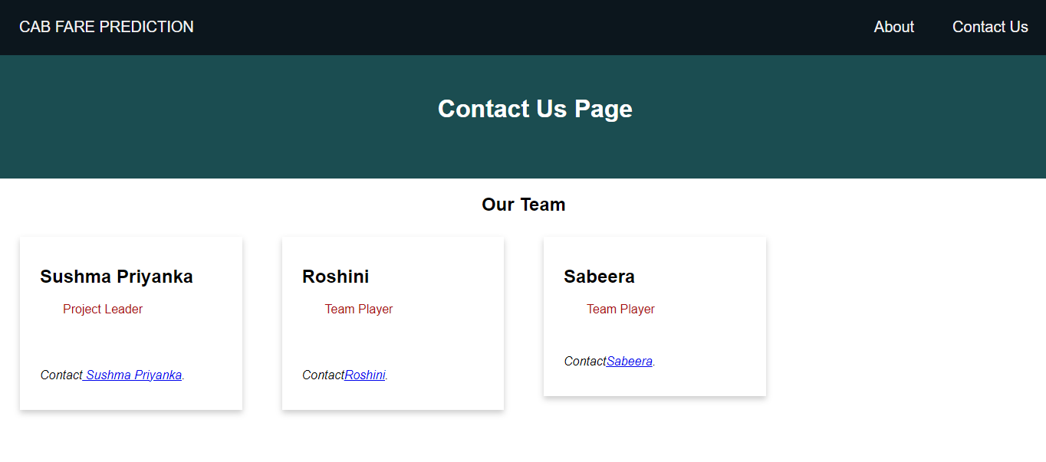
Fig: Output screen for Contact Us page

Slide 25
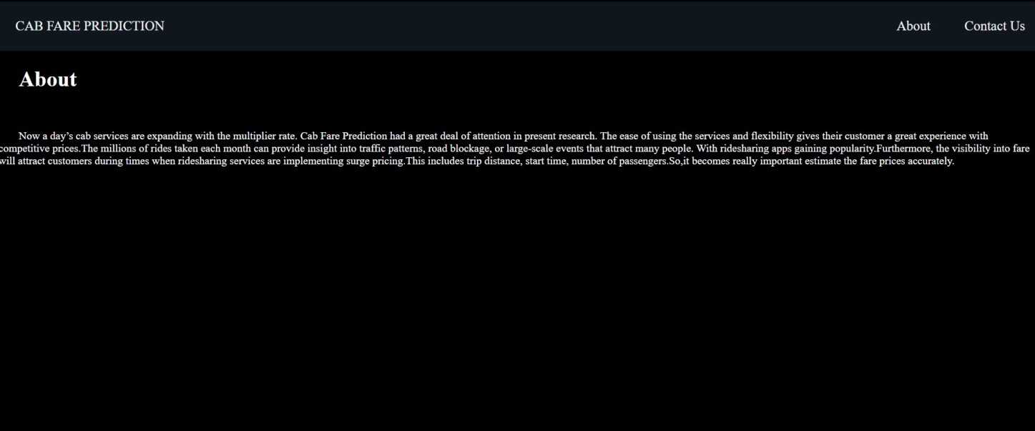
Fig: Output screen for about page

Slide 26
Conclusion-
The accuracy of the fare which we predicted depends on different factors as we have seen till now.
So, for getting more accurate results, we should make sure that we do every task with utmost perfection.
Therefore, we used an algorithm Which is Decision tree so that we can predict results accurately.
Prediction of cab fare can be used in the automobile industry.
The purpose of this research work is to foresee the cab fare.
Thus, the predicting the cab fare we have achieved the objective of our research work.

Slide 27
THANK YOU

